Slide 1
ENGAGEMENT STRATEGIES
July 24, 2023
Notes:
If you are presenting with 2 people, remember to make the second presenter a "co-host" so they can help manage the meeting.

Slide 2
Welcome!
Jeff Nachtigal, Instructor Development Specialist
Morgan Bell, Instructor Development Specialist
Instructor Development Team, Continuum
Sign up for 1-1 consults via Training Calendar
Notes:
https://instructorresource.continuum.uw.edu/training/training-calendar/

Slide 3
Agenda
Building connections and community (trust)
  Icebreakers, get-to-know you, lighten the mood
Engagement strategies
  Small groups/Breakout rooms: Many approaches
Feedback and responses
What did learners learn? What do they need? Learn how you can adjust…
Discussions
Teacher presence
Notes:
Tools to add to your engagement strategies
Use one, or more that click with you and try them out live in a course.
NOTE: We have a lots of content to share today! AND we never know what our audience is familiar with.... so let us know what you know, or want to know...!

Slide 4


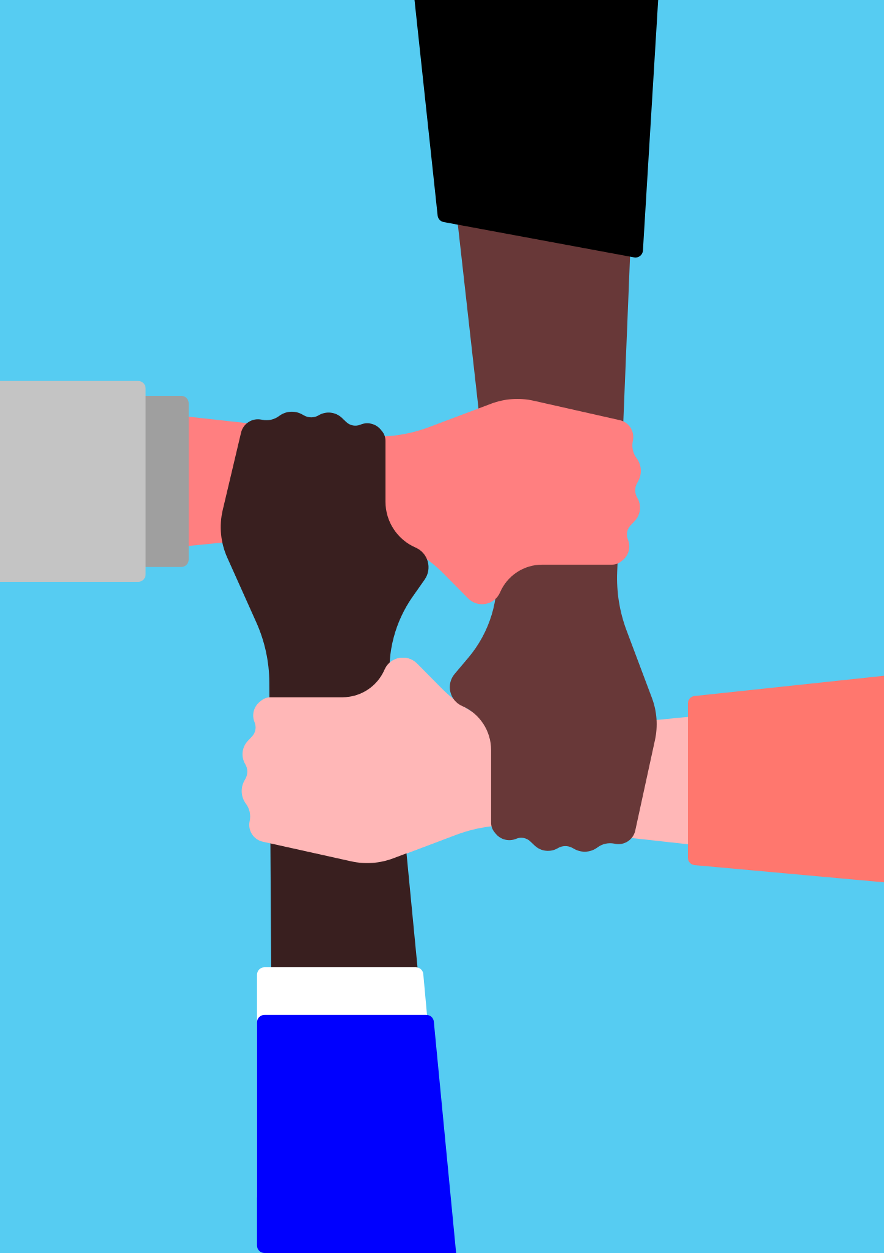

Welcome!
1
2
In the chat, please share which image represents you right now,
and why.
Take 30 seconds.
[Modeling]
3
4
Image credit: Vecteezy.com
Notes:
Icebreaker No. 1

Slide 5
Welcome!
Communication
Critical thinking
In the chat, please share which image represents you right now,
and why.
Collaboration
Creativity
Image credit: Vecteezy.com
Notes:
Icebreakers:
1. Centers everyone on the course
2. Builds community
3. Statistics show
4. Works for small groups or whole class
Link to our coaching calendar is in the chat
We will follow up with shared info and resources

Slide 6
Build connections and community
Foster critical thinking and creativity
Icebreakers: Full class or small groups.
Tools: Zoom chat, Zoom Polls, discussion boards, in Breakout rooms, Google Jamboard...
Notes:
Icebreakers build a culture of communication and connection between students and you.
Consider using an icebreaker at the start (or at some point) in every class.
Icebreakers build group work muscles so learners are used to and ready to work together on small or large tasks/projects
HOW do you use ice breakers intentionally?
First day: Start with an easy, accessible style: Safe, comfortable, build trust and community
Questions to ask yourself, that lead to icebreaker/engagement questions:
No. 1: What do people already know?
No. 2: Areas of need, or challenges related to the content?
No. 3: Events: Check in to make sure everyone is ok, and talk about it. Building support

Slide 7
Principles of Engagement
Instructor performance: Your enthusiasm is contagious
Community: Get to know/connect with each other
Appeal to emotions: Cognitive resources are limited
Stories: Share and create together, more robust take-away from the lesson (real world)

Slide 8
Instructor performance
Engagement begins with you: Whenever possible, model how you want students to interact and communicate.
This includes a clear communication policy outlining etiquette in your syllabus.

Slide 9
Icebreaker example:
Find the app on your phone that you use the most.
Share with your group.
Image credit: Vecteezy.com
Notes:
Icebreaker examples...
Can be 1 minute, or any length of time.
Google "icebreakers online higher ed" for resources/ideas
Ask colleagues for icebreaker ideas

Slide 10

Icebreaker example:
What’s your
Superpower?
Notes:
Icebreaker examples...

Slide 11


Icebreaker example:
ROCK | or | FEATHER?
Notes:
Icebreaker examples...

Slide 12


Icebreaker example:
BAT | or | BALL?
Notes:
Icebreaker examples...

Slide 13
Icebreaker example:
Tell a story: Tell us about something that worked out for you in the past week?
Notes:
Icebreaker examples...

Slide 14
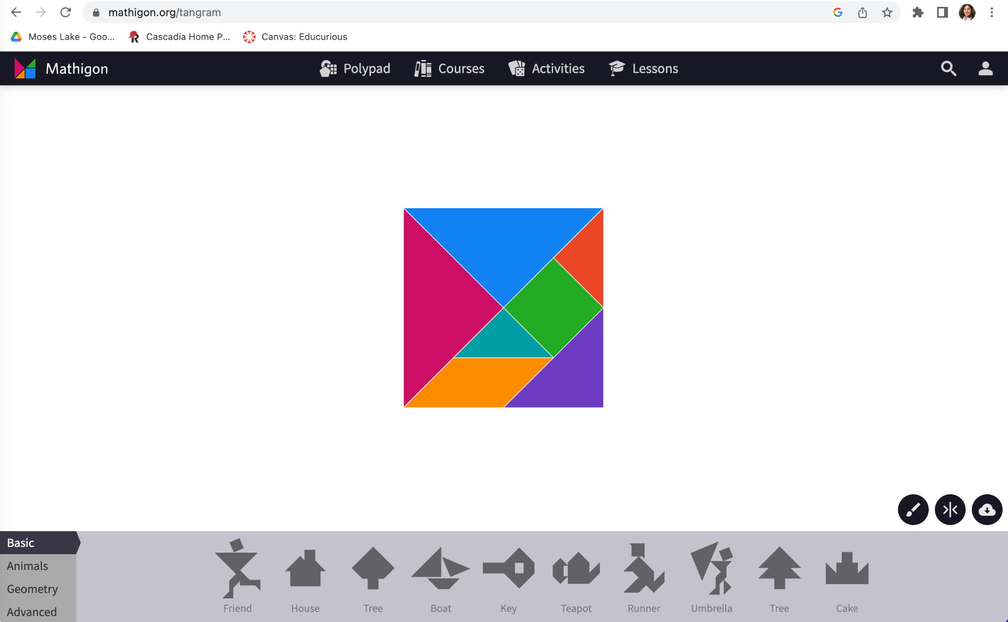

Icebreaker collaboration: Tangram challenge
Introduce yourselves.
Decide who will share their screen.
Other people decide which shapes to build.
Rules: You must use all 7 shapes and they cannot overlap.
How many tangrams can you make together in 3 minutes?
Notes:
Icebreaker examples...
Great group work building exercise:
Tangram: https://mathigon.org/tangram

Slide 15
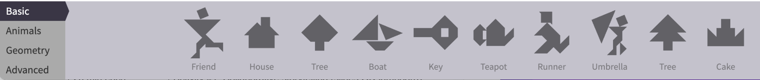
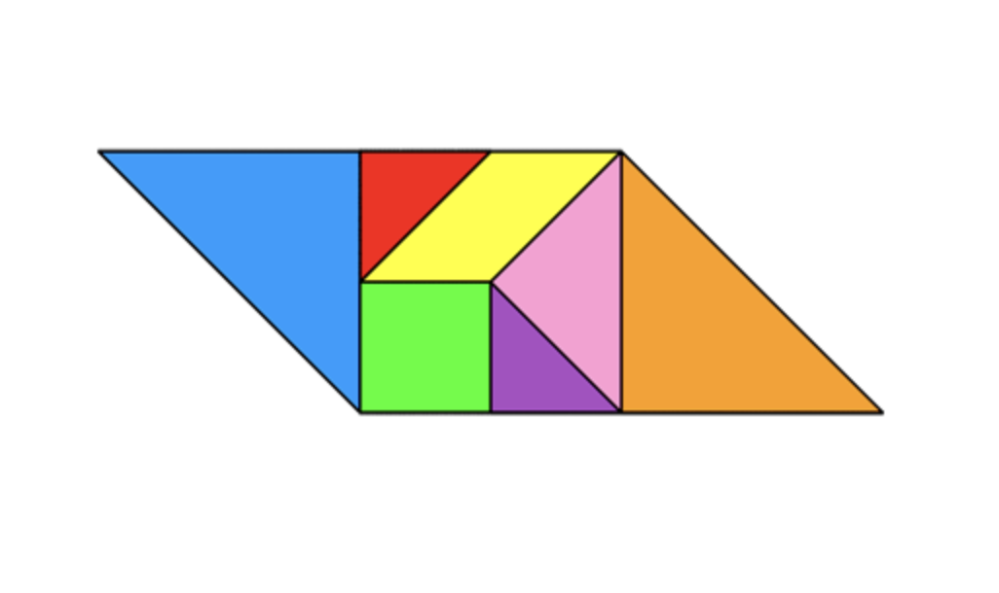
Tangrams: Record which shapes you build!
https://mathigon.org/tangram
Notes:
Tangram: https://mathigon.org/tangram

Slide 16
Debrief: Evaluate icebreakers
Why are icebreakers important?
What should/could happen in icebreakers... to support student engagement?
Hint: The four C's...
[Principles of Engagement: Community + Stories + depending on outcomes of icebreaker/s used]

Slide 17
Debrief: Evaluate icebreakers
What should/could happen in icebreakers to spur engagement?
The four C's...
Communication
Collaboration
Critical thinking
Creativity

Slide 18
Engagement strategies (Part I):
Brainstorming
5-question pause (Jeopardy!)
Debrief activity/assignment

Slide 19
Tools for accountability:
Spokesperson shares out (Roles: Facilitator, time-keeper, researcher, note-taker, spokesperson)
Notes deck (Google slides)
Google Jamboard
Zoom Breakout rooms/Share screen/Whiteboards/Screenshots
Notes:
To complete an engagement activity, ask your students to report the group's "findings."
Collect and compile these links to cloud-based docs on one Canvas page in your course.
Or set up a Google Document page.
Cloud based docs offer transparency – everyone can see, build on and learn from group notes as well
1.Spokesperson: Give everyone in a small group a role
2. Notes deck (Google slides): A shared resource that enhances accountability
3. Google Jamboard: visual tool to compile ideas/notes
Participation grade/assignment for group work: Important formative assessment

Slide 20
Okay, hold on... we've got so much content to cover
Multiple studies show engagement is crucial, especially in digital courses:
"Student learning, persistence, and attainment in college are strongly associated with student engagement. The more actively engaged students are—with college faculty and staff, with other students, with the subject matter they are studying—the more likely they are to persist in their college studies and to achieve at higher levels."
Notes:
Student feedback in Continuum College tells us students want are collaboration and networking opportunities.
Students could sign for Coursera courses, and work alone, but they want to learn together and build community and connections.
In other words, students want engagement in these courses/certificates...

Slide 21
Engagement example:
Brainstorming
Small groups (share out to larger group)
Use Chat or Discussion boards/ Waterfall
Review the ideas in large group
[Principles of Engagement: Community + Stories + Emotion depending on brainstorming content]

Slide 22
Engagement example:
5-question pause (Jeopardy!)
Present a section of learning material
Announce a reflection pause (2 or 3 minutes)
Ask: What made sense? What didn't? (A rose and a thorn...)
Individually, or in small groups.
Students send a question via chat DM and instructor reviews the (common) "thorns" with the full class.
Notes:
Be transparent: take 5 questions and answer the muddiest point"
Pause is important: let students reflect

Slide 23
Engagement example:
Debrief, using Google Slides
Students debrief: A recent assignment, lecture, etc.
Join a Breakout room
Designate one person as the note taker
Each group uses 1 Google Slide deck for notes (accountability)
Debrief discussions/notes as a full class
Today: Debrief an engagement activity you've used as an instructor, or experienced as a student – in your Zoom Breakout room
[Modeling: Breakout rooms, Google slide deck, report back full class]
Notes:
Use this slide as modeling opportunity
Break out rooms x 2
Set up Google Slide deck – send link via Chat:
https://docs.google.com/presentation/d/1YXiOKbdYw9WYQNs24hkKGo8SeBYoZVVfJ8gaWF-pM1U/edit?usp=sharing
Today: Debrief an engagement activity you've used as an instructor, or experienced as a student in a course.
(Demonstrate in Zoom how to set up Breakout Rooms on the fly)

Slide 24
Engagement strategies: (Part II)
Collection and curation
Complete Turn Taking
Visual Prompt
Notes:
Ask students to collect links and resources about the topic. Suggest/find/bring back a resource. Summary/explanation/how related/ pro-con of the resource. Annotated bibliography.
Resource for finding code (add pro/con)
End of unit reflection: Ask students to come back to next course with Qs based on the course content; each students gets a chance to share/ other group members respond; 1 minute to share out to group; group shares back to class.
Equitable and inclusive discussions.
Offer a visual, ask students to respond. String of code with an error. Helps other learners engage by viewing the image.

Slide 25
Engagement example:
Collection and curation (collaborative summaries)
Students compile a collection of resources/links on a topic
Add value: instruct them to include summaries or explanations noting the importance of each resource
Students discuss results in small groups (Designate roles)
Create a Canvas Page to aggregate results – or use another collaborative tool (Google docs...)
Allow students to edit the Canvas Page
[Principles of Engagement: Community + Performance + more depending on content]
Notes:
Please come and talk to us, we are happy to walk thru this with you... more dates coming soon
How to: Instructor view
How to: Student view
Remind participants we can help walk thru any set up in a consult

Slide 26
Engagement example:
Complete turn taking: equitable + inclusive discussion
Small groups of 4 or less, (Roles: facilitator, timekeeper, notetaker, and reporter)
Each student has 1-3 questions on recent course material
1st student has 1 min.to pose a question, others have 1 min. each to respond
2nd student has 1 min. to pose question, others each have 1 min. to respond, and so on...
Key here is that each student's minute is uninterrupted time
Reporter presents highlights back to the class

Slide 27


Engagement example:
Visual prompt
Offer a visual prompt and ask students to respond
Use Chat or Discussion boards/ Waterfall
Or use breakout rooms for small group discussion
Review highlights in large group

Slide 28
Questions?

Slide 29
Discussions: Instructor presence
Just enough, but not too much
Reply to everyone, at one point in quarter (5 per week)
Don't necessarily reply to everyone in a thread
Steer the conversation or provide a clarifying point, if needed
Simple replies matter to learners ("Hi, Good point! Thanks")
Ask several students to "monitor" the board per week
More: https://teaching.washington.edu/engaging-students/discussions/
[Principles of Engagement: Performance, modeling behavior + action]
Notes:
https://teaching.washington.edu/engaging-students/discussions/

Slide 30
Instructor presence: Discussions
The US Department of Education (1) and the Higher Learning Commission (2) (HLC) have required "regular and substantive interaction between the students and the instructor" (1) in online courses. Additionally, research has consistently shown that a strong sense of instructor presence and frequent and meaningful faculty to student interactions improve student persistence (3), satisfaction (4), and achievement (5) in online courses.

Slide 31
Discussions: (engaging) approaches
Post a reflection based on the discussion prompt
Expand on someone else’s post
Suggest ways to refine an idea or argument
Ask a question or ask for clarification about what someone else posted
Identify a theme emerging in the discussion board
Connect someone’s ideas to your own thoughts or experiences
Notes:
https://teaching.washington.edu/engaging-students/discussions/

Slide 32
Feedback/closing activities:
Survey
Reflection
Debrief
Notes:
Use a Zoom poll, or Poll Everywhere
Ask students to share/answer simple question: About the day’s material, unit material, a recent assignment, a recent assessment, project...
These questions show students you are being responsive, you get immediate data about students (Use a poll)
This is engagement!

Slide 33
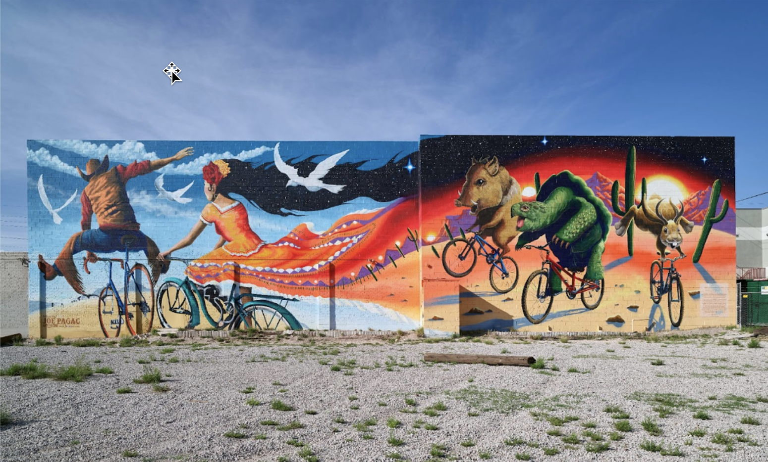
Feedback: Survey
How's the ride been so far?
Please complete the
survey
Notes:
Zoom poll
Canvas survey, send link

Slide 34
Feedback: Debrief
Excited about?
Unsure about?
Connections looking forward?
Let's talk: Q/A
Notes:
Let's talk: Q/A

Slide 35
Sign up for 30-minute, 1-1 consultations
Continuum College Coaching Calendar
https://instructorresource.continuum.uw.edu/training/training-calendar/
Notes:
We love to meet instructors to talk over education tech, or pedagogy

Slide 36
THANK YOU!

